Slide 1
Show Call Manager

Slide 2
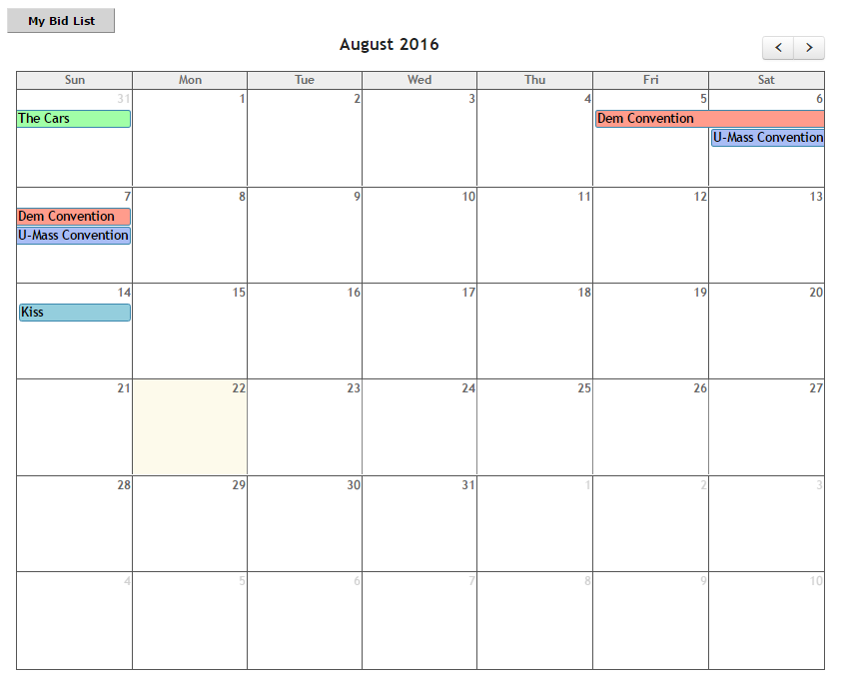
Event Management
Admin View

Slide 3
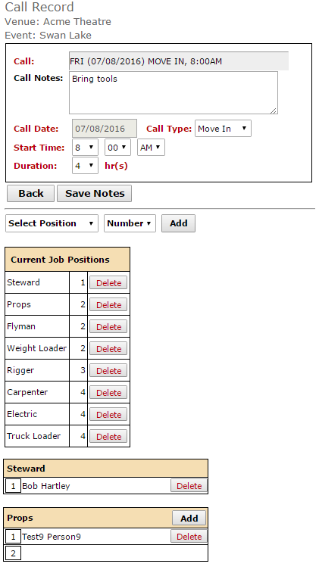
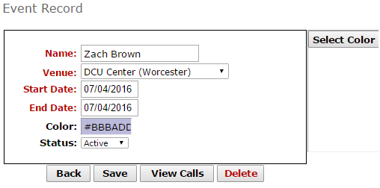
Event Management
Create Event
Create Calls

Slide 4
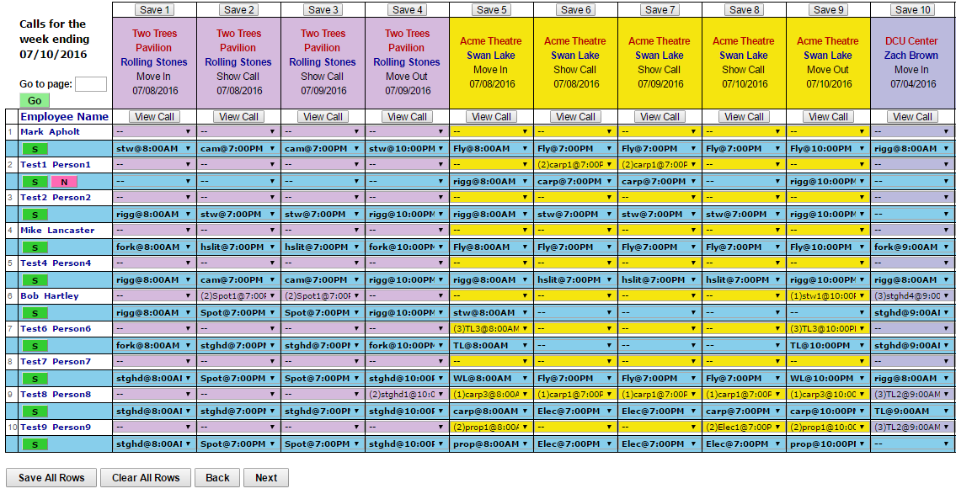
Event Management
Call Fulfillment

Slide 5
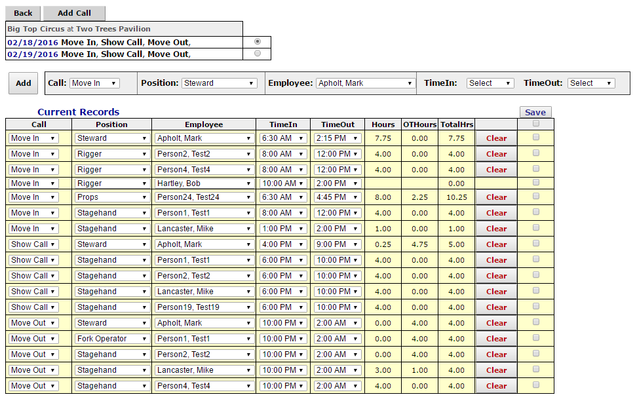
Event Management
Event Time Sheets

Slide 6
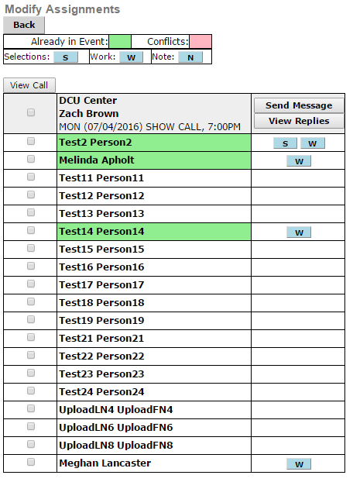
Event Management
Modify Assignments

Slide 7
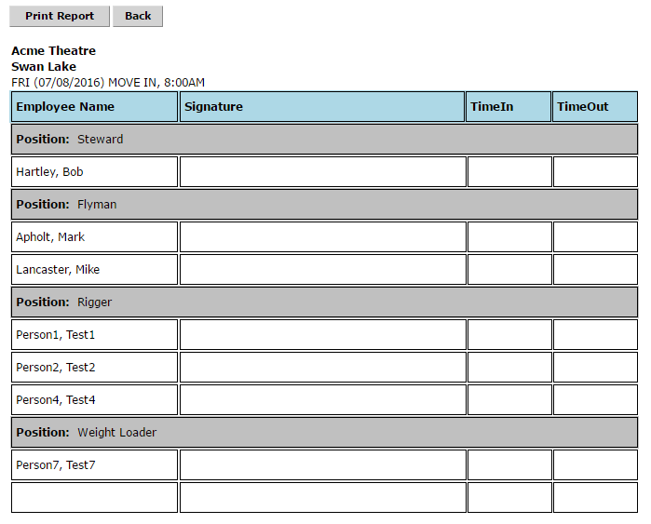
Event Management
Print Sign in Sheets

Slide 8
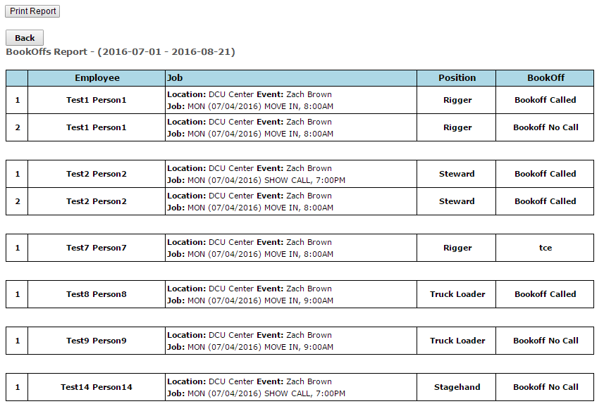
Event Management
Track Book-Offs

Slide 9
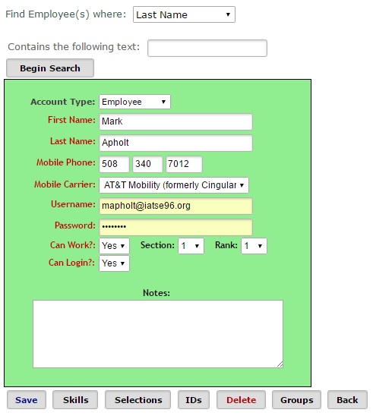
Employee Management
Employee Database
Date of Hire
Skills
Email
Phone Numbers
Payroll Id Numbers
Rank
Group Management
Notes

Slide 10
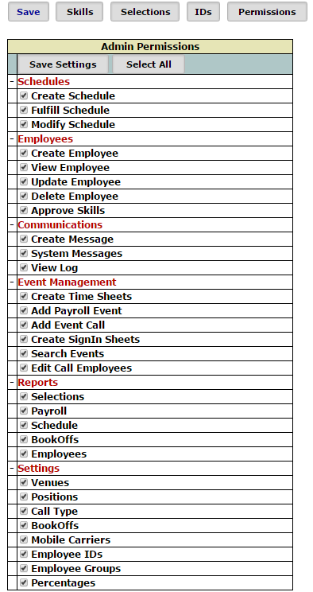
Employee Management
Security Levels
Employee
Administrator
Super-User

Slide 11
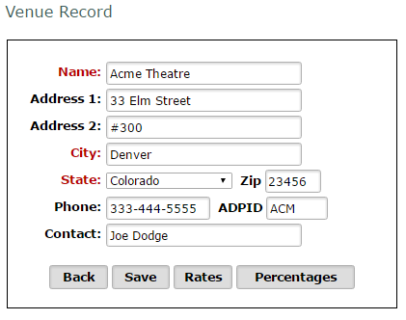
Venue Management
Venue Database
Contact Info

Slide 12
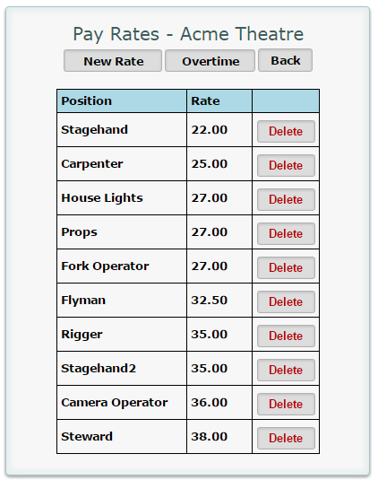
Venue Management
Venue Database
Contact Info
Pay Rates
Holidays

Slide 13
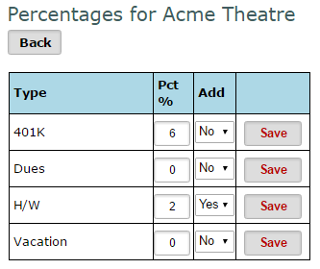
Venue Management
Venue Database
Contact Info
Pay Rates
Holidays
Percentages
Position Management

Slide 14
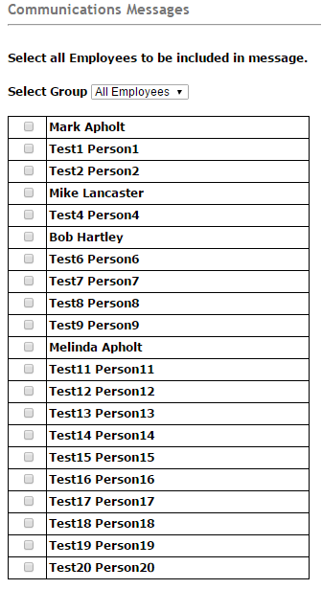
Communications
Email
Group
Individual
Text Messages
Group
Individual

Slide 15
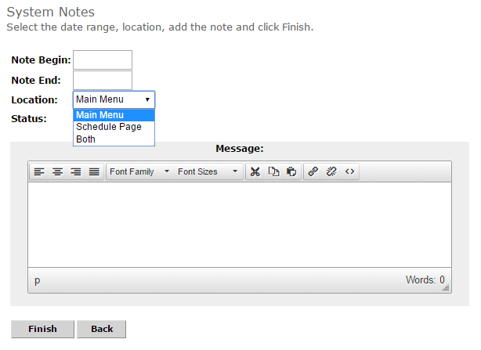
Communications
System Messages

Slide 16
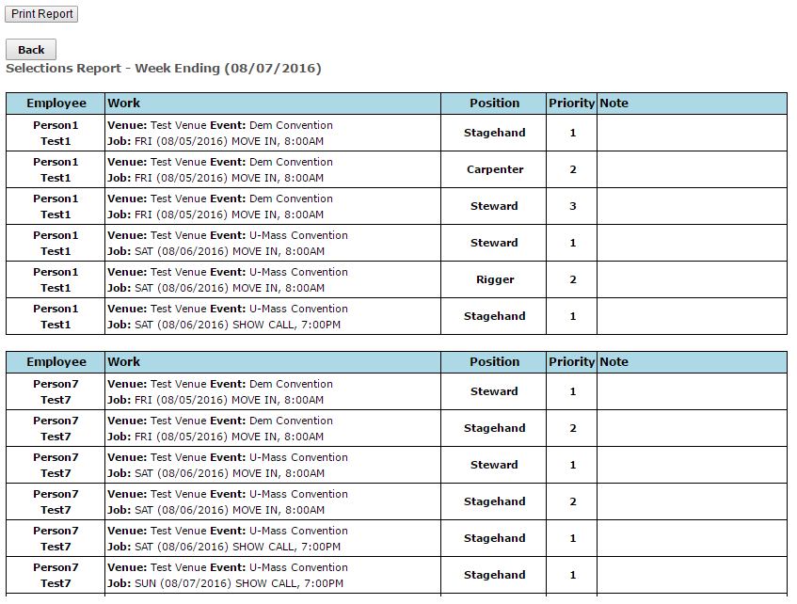
Reporting
Selections
Employee Bid Reports

Slide 17
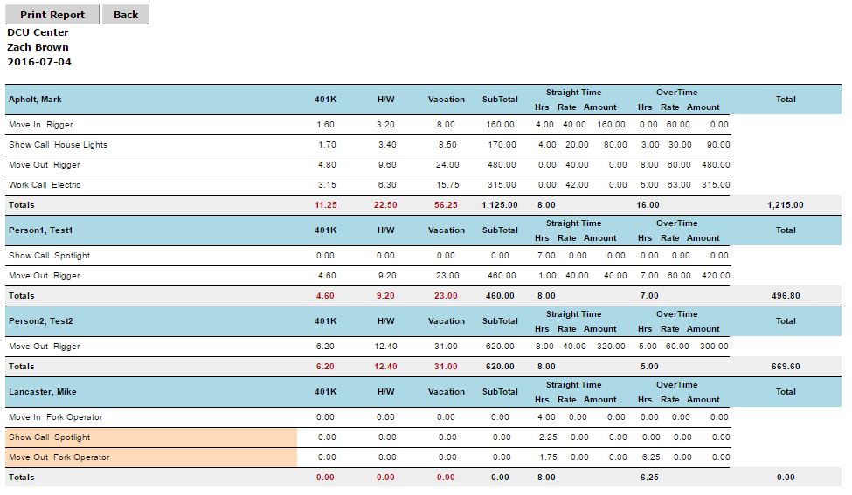
Reporting
Payroll
Event
Hours
Rates

Slide 18
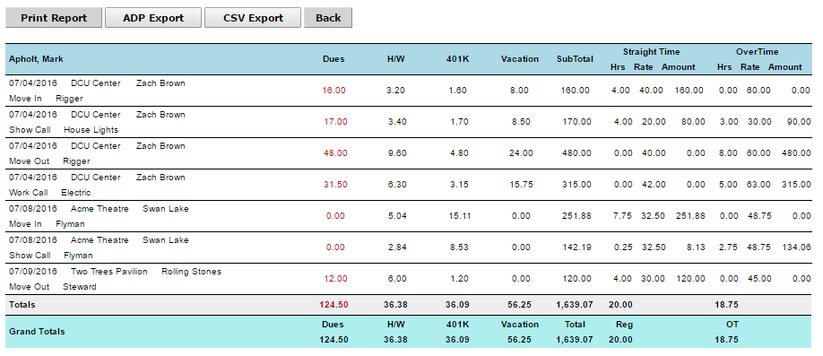
Reporting
Payroll
Date Range
One employee or all
Venue

Slide 19
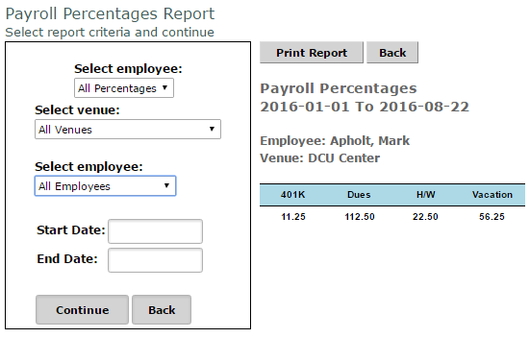
Reporting
Payroll
Percentages
Sort by Percentage, Venue, Employee

Slide 20
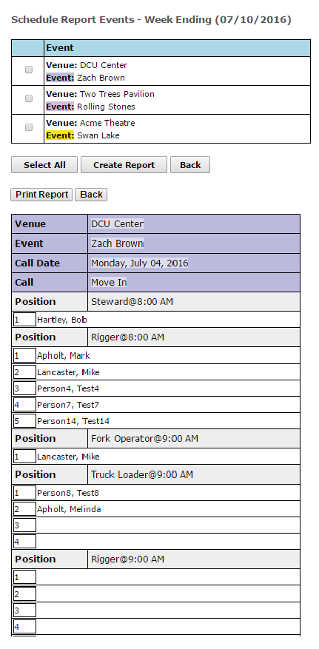
Reporting
Schedule
One or all events
By week ending

Slide 21
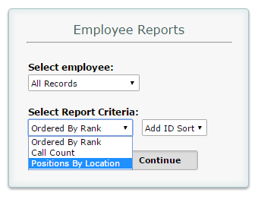
Reporting
Employees
Rank
Position by Location
Call Count
Skill

Slide 22
Reporting
Book-Offs
By Date
By Book-Off Code

Slide 23
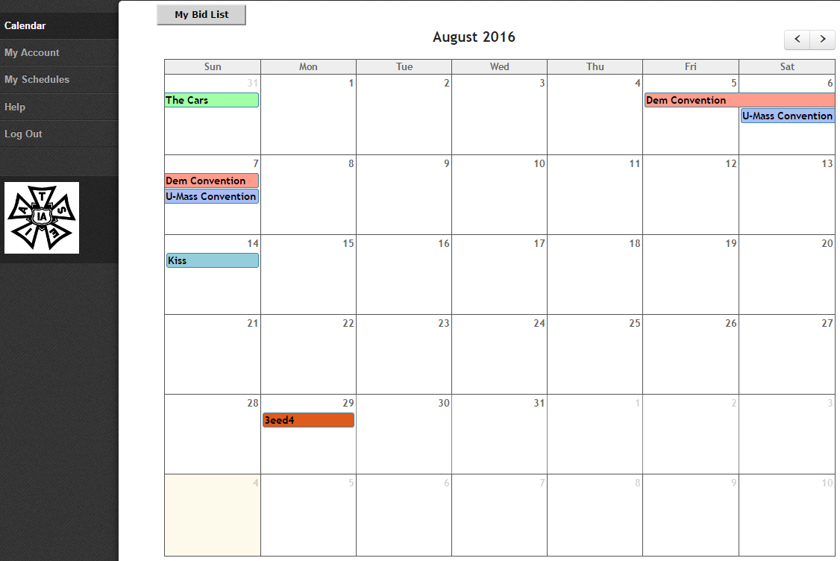
Employee Portal
Calendar
Current & Past Shows
Select Show to Bid on Work
My Bid List
By Show
By Week

Slide 24
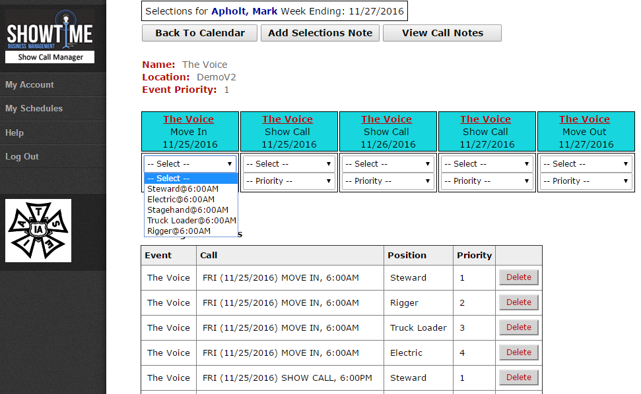
Employee Portal
My Bid list
By Event Priority
By Position Priority

Slide 25
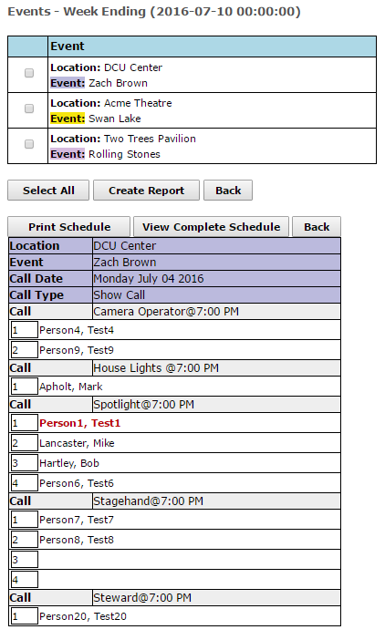
Employee Portal
My Schedules
By event
By Week

Slide 26
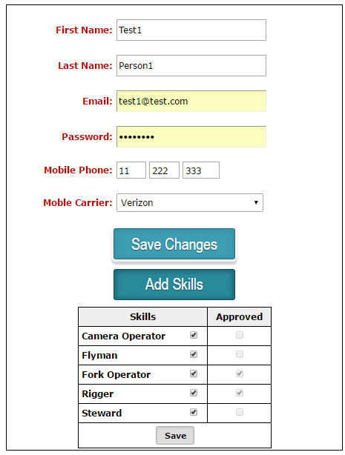
Employee Portal
My Account
Name, Email Password,
Skills

Slide 27
Thank You
Mark Apholt
Mike Lancaster
1-800-966-9652

